Slide 1
2022 County Legislative Priorities
www.pacounties.org

Slide 2
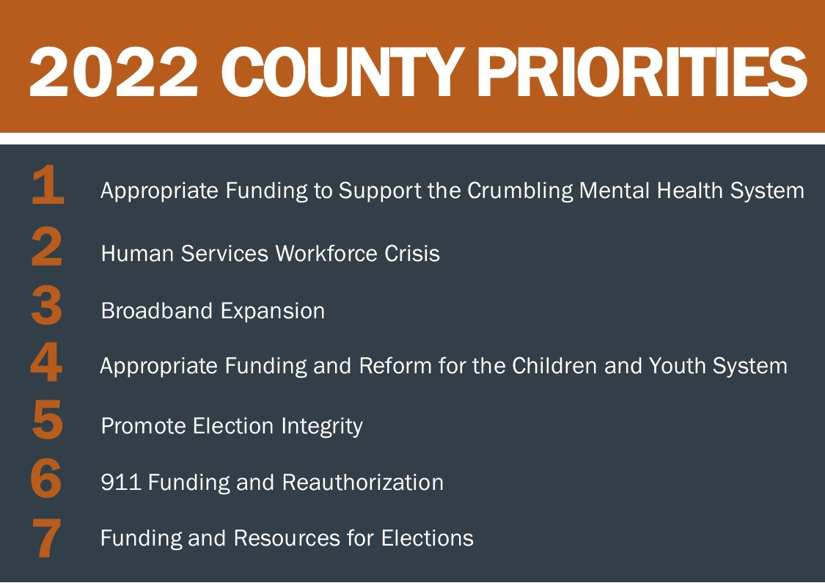
Overview
www.pacounties.org

Slide 3
2022 Legislative Priorities
Demonstrate the wide range of services counties provide on behalf of the state
Promote collaboration between federal, state, and local governments leads to solutions and better outcomes for Pennsylvanians
www.pacounties.org

Slide 4
Appropriate Funding to Support the Crumbling Mental Health System
Increase in Funding:
Mental health community base needs a targeted, strategic investment of state dollars to stabilize and strengthen community crisis services, residential mental health programs and other locally-provided care.
Additionally, counties need the assurance of annually increased investments in the mental health community base to fortify the existing safety net of services.
Behavioral HealthChoices Program:
Preserve the Behavioral HealthChoices program, so that counties can continue to provide local mental health services effectively and efficiently.
www.pacounties.org

Slide 5
Human Services Workforce Crisis
Program Development:
Development of programs and partnerships to streamline human services recruitment efforts and create county employment pipelines.
Removing Regulatory Barriers:
Permitting professionals to operate within their scope of practice and expertise, regardless of regulatory or degree requirements, to aid in service provision and delivery.
Further reduction or elimination of regulatory barriers to ease burdens on county human services staff.
www.pacounties.org

Slide 6
Broadband Expansion
Collaboration:
Working together with federal, state, local and private stakeholders to develop strategies for successful broadband expansion that maximizes resources and minimizes overbuild.
Identifying funding resources and partnering with stakeholders to ensure deployment of resources are responsibly allocated to best fit the areas of greatest need.
Best Practices:
Identifying successful approaches and sharing best practices that can be replicated with other comparable communities.
www.pacounties.org

Slide 7
Appropriate Funding and Reform for the Children and Youth System
Funding:
Securing adequate funding from the state to enable hiring necessary caseworkers to address increasing caseloads.
Reducing Barriers:
Reducing or removing regulatory barriers that would ease burdens on county children and youth staff, increase training and collaboration with law enforcement and work to eliminate cross-systems barriers.
Statewide Plan Addressing Complex Cases:
Taking steps to encourage the state to play a more active role supporting counties by implementing a statewide program and resources to assist counties in addressing the most complex cases that require specialized programs and treatment options.
www.pacounties.org

Slide 8
Promote Election Integrity
Clarifications to Act 77 of 2019:
Counties must have clear rules to help restore the public’s confidence in the integrity of our elections.
Counties seek clarification on and stand ready to assist resolving ambiguous elements of Act 77, including drop boxes, permanent voter lists, ballot signatures and other fatal flaws.
State-county partnership must be leveraged:
Ensuring that counties are involved in the development of any election law reforms to create positive, meaningful and effective election policy clarifications moving forward.
www.pacounties.org

Slide 9
911 Funding and Reauthorization
Adequate Funding:
Development of a funding formula, well ahead of the 2024 sunset, that adequately supports current county needs and ensures that funding sources and distribution support needs into the future.
Opportunities for system and funding consolidation, including regional resource sharing and collaboration to ensure system and service continuity.
Investment in Evolving Technology:
Continued strategic planning and investment for evolving technologies and GIS data to ensure NG911 is properly supported and maintained.
www.pacounties.org

Slide 10
Funding and Resources for Elections
Appropriate Financial Resources:
Ensuring that appropriate financial resources are allocated from the state to counties to support any new challenges in election procedures, requirement or equipment.
Allocating sufficient time, in consultation with counties, to implement any new requirements, training or procedures for elections administration.
Recruit and Retain Election Staff:
Supporting efforts to recruit and retain county elections staff, including establishing reasonable workload expectations with new laws and policies, to continue efficient and effective elections operations across the commonwealth.
www.pacounties.org

Slide 11
Questions?
Please submit questions in the chat box.
Thank you for participating!
www.pacounties.org

